Slide 1
Crowdsourcing Software Validation and Verification
Christian Adriano

Slide 2
Index
Definitions
Applications
Crowdsourcing Fault Localization

Slide 3
Crowdsourcing for software engineering tasks
“Open call for contribution to a potentially largen and unspecific group of people” – La Toza

Slide 4
Common conceptions and concerns
Quality
Task design
Pricing
Security
Privacy
Recruiting
Delegation

Slide 5
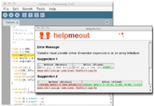
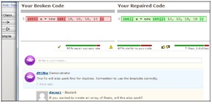
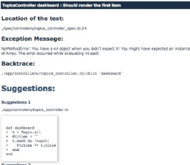
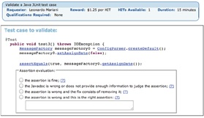
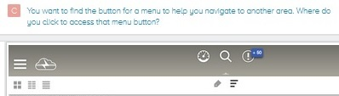

Applications
Workers receive short suggestions on compilation errors
Help Me Out (Hartmann et al. 2010)
BlueFix (Watson, Li & Godwin 2012)
Workers receive short suggestions on failing unit tests
Crowd::Debug (Mujumdar et al. 2011)
CrowdOracles (Pastore, Mariani & Fraser 2013)
Workers receive short questions on GUI usability
www.fivesecondtest.com
Voyant (Xu, Huang & Bailey 2014)
Notes:
Usability Test
Fivesecondstest - http://fivesecondtest.com/ (also give a look at usabilla.com)
(Xu, Huang & Bailey 2014) Xu, A., Huang, S. W., & Bailey, B. P. (2014). Voyant: Generating Structured Feedback on Visual Designs Using a Crowd of Non-Experts. Urbana, 51, 61801.
Error Messages
(Hartmann et al. 2010) Hartmann, B., MacDougall, D., Brandt, J., & Klemmer, S. R. (2010, April). What would other programmers do: suggesting solutions to error messages. In Proceedings of the SIGCHI Conference on Human Factors in Computing Systems (pp. 1019-1028). ACM.
(Watson, Li & Godwin 2012) Watson, C., Li, F. W., & Godwin, J. L. (2012). BlueFix: using crowd-sourced feedback to support programming students in error diagnosis and repair. In Advances in Web-Based Learning-ICWL 2012 (pp. 228-239). Springer Berlin Heidelberg.
Unit Tests
(Mujumdar et al. 2011) Mujumdar, D., Kallenbach, M., Liu, B., & Hartmann, B. (2011, May). Crowdsourcing suggestions to programming problems for dynamic web development languages. In CHI'11 Extended Abstracts on Human Factors in Computing Systems (pp. 1525-1530). ACM.
This paper (Mujumdar et al. 2011) demonstrates a tool named “Crowd::Debug”. Their user studies generated a total of 161 fixes.
Participants queried Crowd::Debug 211 times, and Crowd::Debug suggested useful fixes in 120 cases (57%). 38 times (18%) suggestions were not useful,
and for 30 bugs (14%), no fixes were suggested. In 23 cases (11%) the tests contained errors that prevented execution to reach to the point where the
(Pastore, Mariani & Fraser 2013) Pastore, F., Mariani, L., & Fraser, G. (2013). CrowdOracles: Can the Crowd Solve the Oracle Problem. In International Conference on Software Testing, Verification and Validation (ICST).
------------------------------------------------------------ Just a review - can we do crowdsourcing in se?
[16:07:08] André van der Hoek: Well, some attempts have been made - or can list them.
[16:07:27] André van der Hoek: and then move on to the next slide - my work is about debugging.

Slide 6
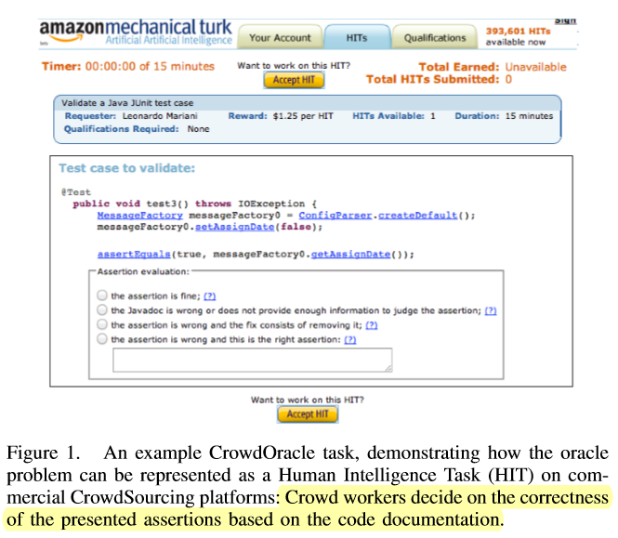
Crowd Oracles
Pastore, F., Mariani, L., & Fraser, G. (2013, March). Crowdoracles: Can the crowd solve the oracle problem?. In Software Testing, Verification and Validation (ICST), 2013 IEEE Sixth International Conference on (pp. 342-351). IEEE.

Slide 7
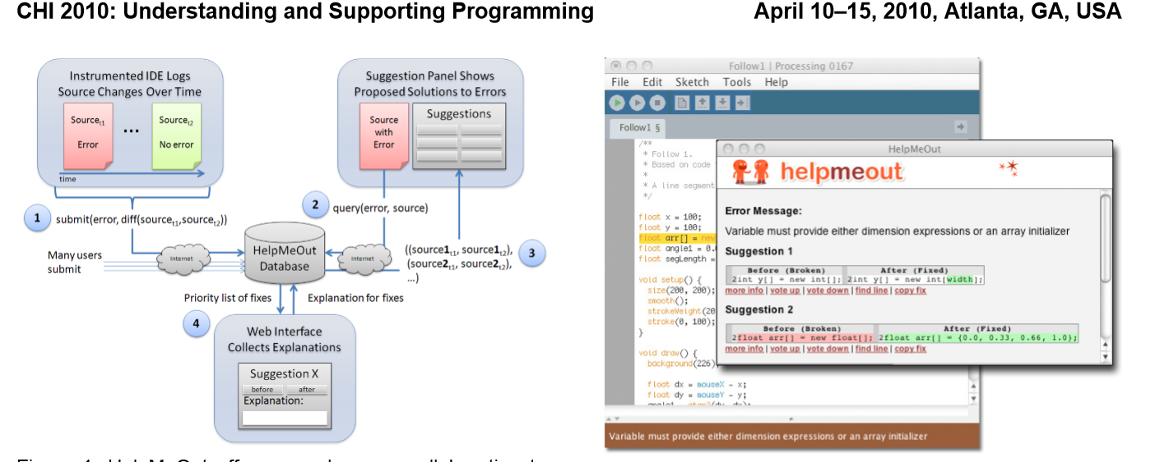
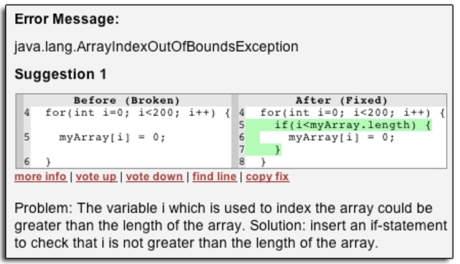
Help me out
Hartmann, B., MacDougall, D., Brandt, J., & Klemmer, S. R. (2010, April). What would other programmers do: suggesting solutions to error messages. In Proceedings of the SIGCHI Conference on Human Factors in Computing Systems (pp. 1019-1028). ACM.

Slide 8
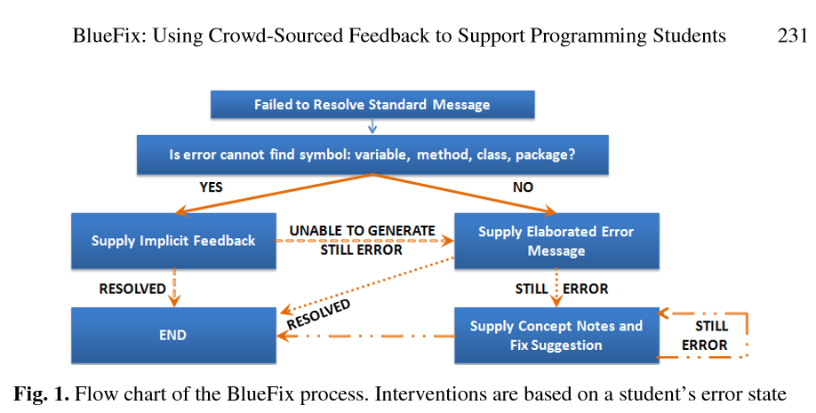
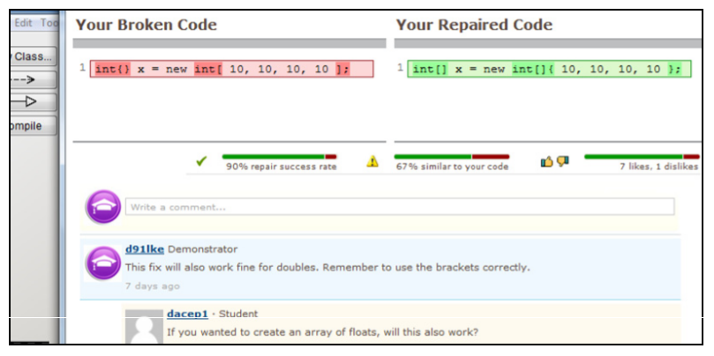
BlueFix
BlueFix (Watson, Li & Godwin 2012)

Slide 9
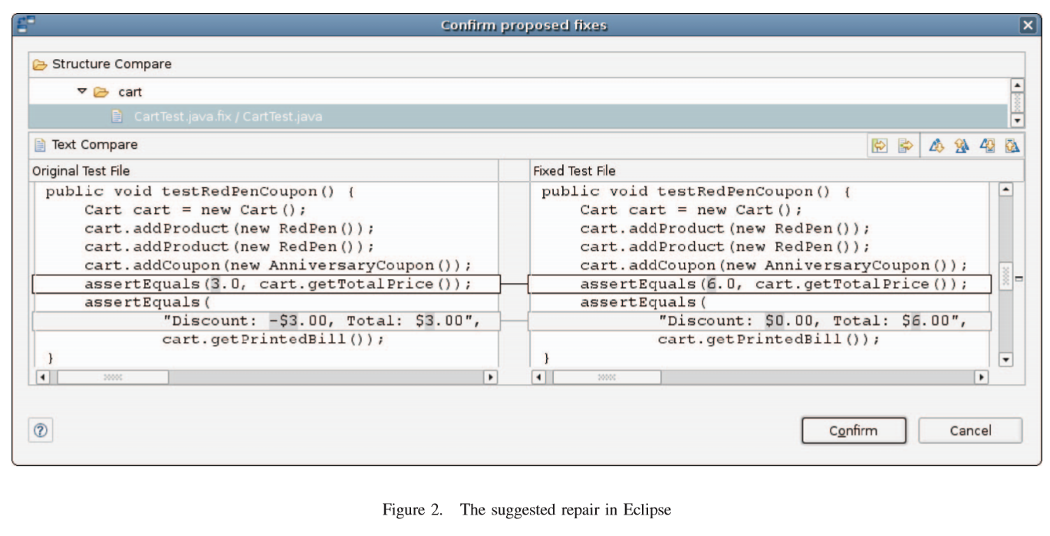
Reassert
Daniel, B., Jagannath, V., Dig, D., & Marinov, D. (2009, November). ReAssert: Suggesting repairs for broken unit tests. In Proceedings of the 2009 IEEE/ACM International Conference on Automated Software Engineering (pp. 433-444). IEEE Computer Society.

Slide 10
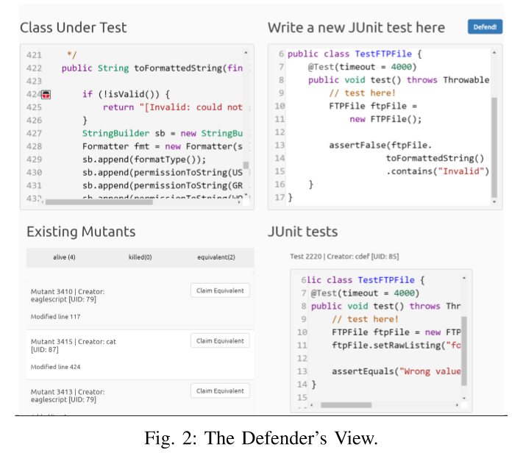
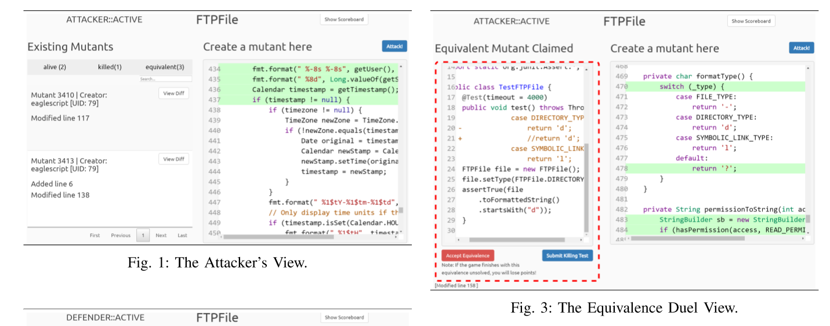
Crowd testing - Gamification

Slide 11
Crowdsourcing fault localization

Slide 12

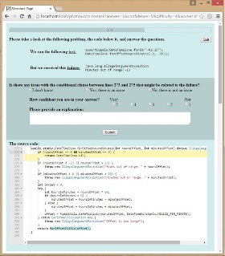
Open loop scenario
Failing Java methods
Distribute
Recruit programmers
Open-call for contributions
Faults located
Complete tasks
Java
Scope of our exploration:
Single Java method
Simple bugs
Notes:
SCENARIO
Slide-1
Scenario (explain the chart)
Start with failing Java methods being crowdsourced via an open call to an undefined large group of workers
Recruit workers from a microtasking platform
Execute task in an external interface specially created to collect worker responses
Aggregate outcomes to predict the location of a fault inside a method.
MOTIVATION:
With so many automated tools for fault localization, why would we even want to do this?
Faster work, by means of parallelization
Cheaper
Use available work time because microtasks take little time to complete
Spread knowledge about the code
Train new programmers on a source code
SCOPE:
In order to explore whether a crowd can locate faults, we started with a very simple case:
Faults are simple and located in one Java method that was exposed by a unit test failure
Hence, the fault is already located at the method level. The mission of the crowd is to discover where within the method the fault is.
Goal: Investigate whether a crowd can actually locate the fault that was exposed by a failed unit test
First step: Unit test failures that are caused by faults located in a single Java method
We are not yet:
Automating the selection of the Java method that will be crowdsourced
Handling failures caused by multiple faults or faults affecting global states
Deciding which questions to ask and when as we make sense of workers answers
Concerning the scope of my exploration:
Single java methods = the actual failing method, however, the reality of unit test is that multiple methods are called, even whe are dealing with target method of test
Simple bugs= faults are located at a single line of code, most people can identify it by simply reading the source code, i.e., people don’t need to inspecting the runtime state at the moment of the failure in order to locate the fault. Hence, I am dealing yet with faults related to global states or even concurrency bugs.
Nonetheless, simple bugs are pervasive. A recent study show that up to 40% of bug fixes affected a single file. Anedoctally, how many of us were once debugging for a few long minutes and colleague comes, looks over our shoulder, and quickly pinpoints the line that is the culprit of the mysterious failure? In other words, the enacting of the given enough eyes and all bugs are shallow (Raymond – the Cathedral and the Baazar).
How to partition fault localization among multiple workers?
How to recruit enough workers with basic programming skill?
How to distribute microtasks?
What type of work is meaningful to be performed as microtasks?
How to aggregate the outcomes?

Slide 13
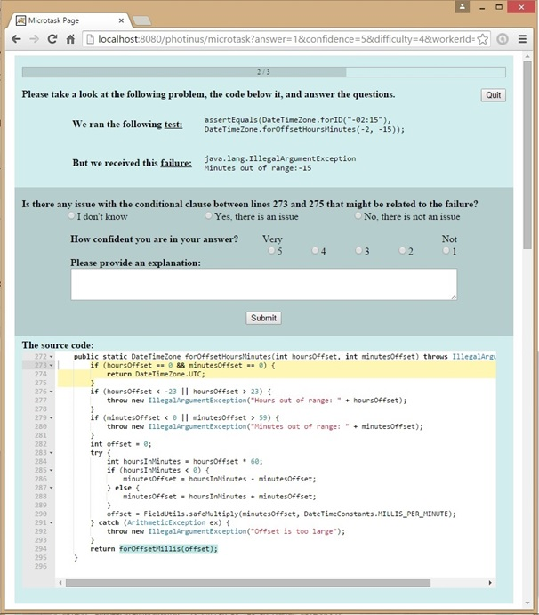
The microtask GUI
Unit Test
1
Failure description
2
Question and Answers
3
Confidence
4
Explanation
5
Source code
6
Notes:
Colors to focus worker on the most frequently used information
Progress bar so workers can gauge the time they spend in each microtask
Quit button to collect the reasons for quitting
Information available
Redundancy to increase efficiency (yellow highlight and blue highlight)
Answer design
3 types of answers only, I don’t know first
Separate confidence level from answer option
Explanation because (see below)
About explanation text field
Explanation is important to understand the rationale that supported the worker’s answer choice. For example, if the workers answered “yes, there is an issue”, what is the hypothesis for the failure, i.e., how a fault is causing a failure? If they say I don’t know, what was the difficulty they faced? For instance, they need more context about how the code is being used or how it relates to other parts of the system, or they needed more information about the program state or the specifications. If they say No, why are they confident that the failure is not in that program statement?
Such explanations can also be used to later on by the programmer who will fix the fault.
-----------------------------------------------------------------------------------------
Comments:
Holger - replay the unit test, show execution states, lost of context when move from one method to another,
Leen – are people allowed to debug the software
Joachin – do they have access the test?

Slide 14
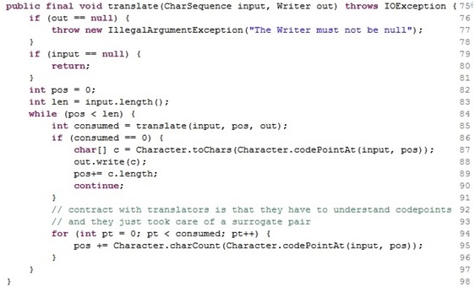
How do questions cover the location of a fault?
QUESTIONS
q1
q2
q3
q4
q5
q6
q7
q8
no
no
yes
q2
no
yes
yes
yes
no
yes
no
no
yes
yes
yes
q3
yes
no
no
yes
no
yes
no
q1
yes
no
yes
yes
no
yes
q4
yes
no
yes
no
yes
yes
yes
yes
no
yes
q5
no
q6
yes
q7
q8
yes
no
q1- Is there any issue with the loop between lines 94 and 97 that might relate to the failure?

Slide 15
How many filters located all faults?
# subcrowd | selection | precision, recall | lines to inspect | workers | answers
1 | non-students score = 100% | 94%, 65% | 51 | 133 | 836
2 | only score = 100% | 94%, 65% | 51 | 194 | 1121
3 | least difficult answers by worker score | 88%, 61% | 42 | 418 | 1868
4 | all non-students | 81%, 76% | 56 | 316 | 1173
5 | least difficult answers by worker profession | 81%, 61% | 43 | 454 | 2279
6 | all workers | 79%, 64% | 43 | 497 | 2580
7 | excluded fastest answers | 78%, 59% | 41 | 488 | 2395
8 | top 3.3% confidence answers | 71%, 56% | 42 | 412 | 1749
9 | excluded shortest explanations | 70%, 66% | 57 | 412 | 1879
Notes:
We applied filters for other sets of features. I filtered workers by test score, profession, and years of experience. Answers were filtered by duration, confidence, difficulty, explanation size.
After applying a set of filters, we obtained different subgroups of workers that we call subcrowds, who also located all 8 faults, but with different levels of precision and recall. Table-x shows 8 of these subcrowds in detail. We can see in the table that a subcrowd composed solely by non-students had the highest F1 score. Notice also that these subcrowds are not disjoint sets, for instance, >80% score non-students contain the subcrowd of 100% score students, therefore, they have different number of workers, which imply different costs.

Slide 16
Affinity diagram session

Slide 17
Categories
Root-cause of a bug
Description of the program
Description of the failure
Request for more information
Suggestion of a fix

Slide 18
Questions - 1(low) to 5(high)
What is the level of confidence of the worker?
What is the quality of the explanation?
What is your level of confidence that you understood the explanation?
Which question would you ask based on this explanation?

